Slide 1
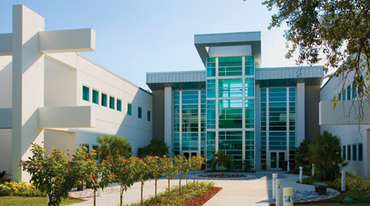
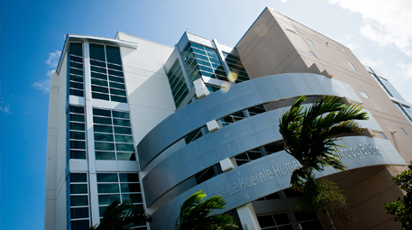
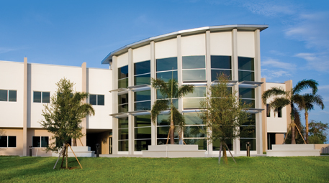
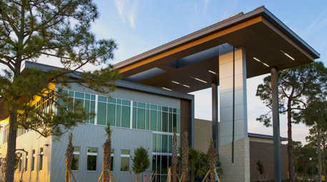

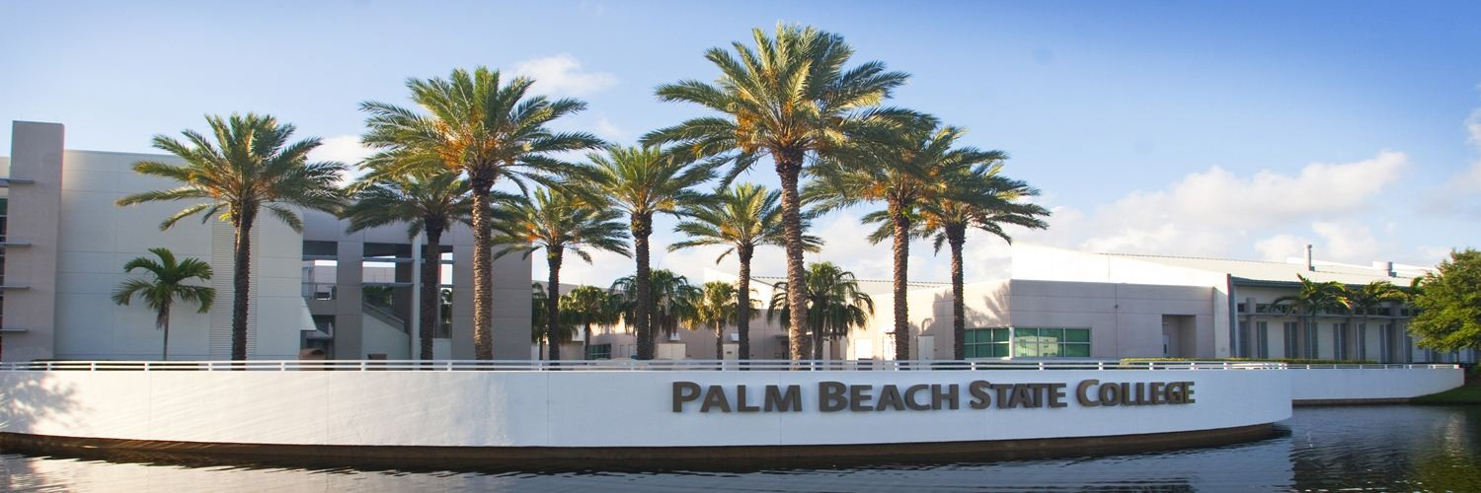

Palm Beach State College
District Board of Trustees Meeting
October 17, 2023

Slide 2
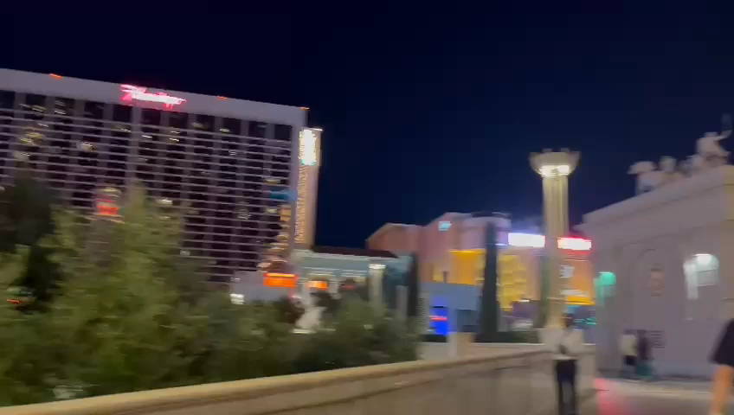

Slide 3
Palm Beach State College
District Board of Trustees Meeting
October 17, 2023

Slide 4


Palm Beach State College
District Board of Trustees Meeting
SoFi Center Update
Dr. Stephen Joyner
Provost & Dean, PBG Campus
October 17, 2023

Slide 5
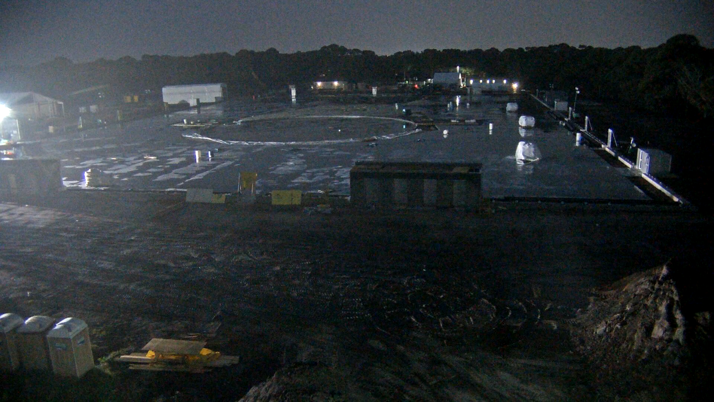
Title

Slide 6
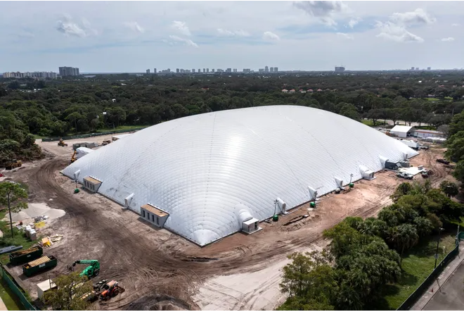

nearly 250,000 sq.ft. venue
75 ft tall
300 ft. wide
447 ft. long
1500 seating capacity
Picture curtesy of Greg Lovett, The Palm Beach Post, 10/12/23

Slide 7
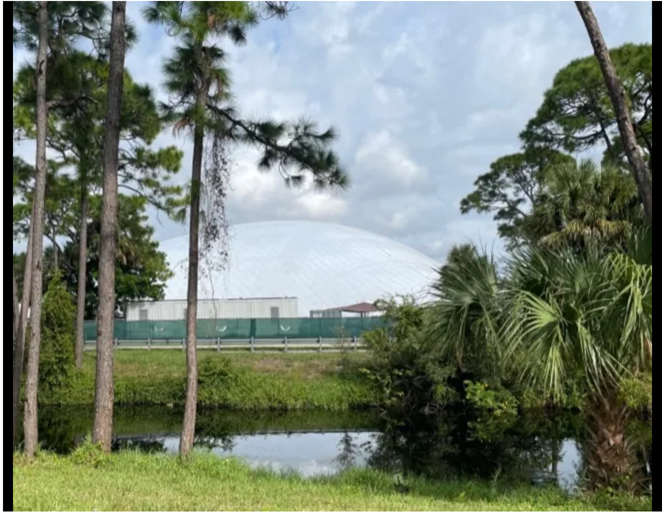
Picture curtesy of Greg Lovett, The Palm Beach Post, 10/12/23

Slide 8
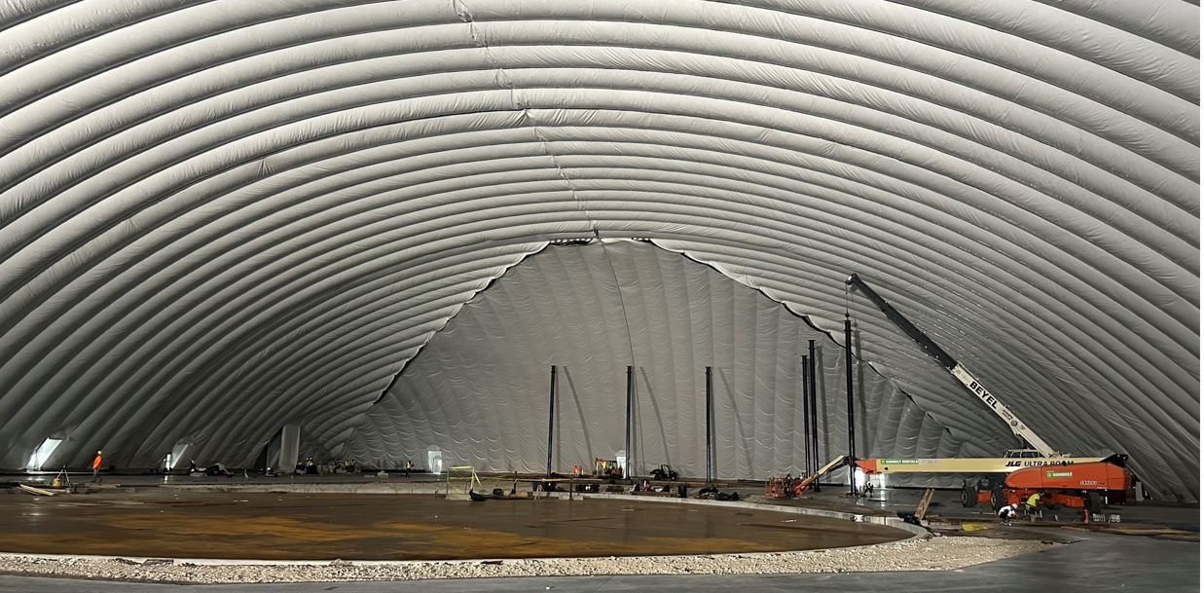

Slide 9
SoFi Center Next Step Milestones
OCTOBER 2023
Dome Inflation (Complete)
Permits Secured
Scenic and Structural Steel
Installation
Turntable Installation
Tech Cabling Installation
Slab Foundation Complete
Rigging Grid Installed
Tee Box Assembly Complete
NOVEMBER 2023
Broadcast Installation
Turf Installation
Water/Wastewater Tied Into City
Top Tracer Installation
Tech End-to-End Testing
Rehearsals
DECEMBER 2023
Permanent Power
Seating Complete
Certificate of Occupancy
Dress Rehearsals
Locker Rooms, Rest Rooms & VIP
Club Modular Units Installed
Retail Staging
Concession Staging
Landscaping Complete
Scenic Complete
JANUARY 2024
Full rehearsals
Go Live 1st Broadcast January 9

Slide 10
SoFi Center Student Opportunities
STUDENT INTERNSHIPS:
Tomorrow Sports academic program partnerships:
Data Science – tentative start date 11/6
Technical Support
Systems/Networking
Cyber Security
Venue Technology
Data Analytics
Process Automation
Project Management
Other internships not IT; i.e., broadcast, film, graphics
to be identified by PBSC
STUDENT SITE VISIT (After Dome Inflation)
94 Students – HVAC, Electrician, Low Voltage, Machining Group, Welding
JOB FAIR - Business Operations Positions– 25 paid positions
Early November - Staff positions with venue operator, OVG, hospitality, security, etc.
NEW CURRICULUM DEVELOPMENT
Sports Management, Venue Management, Business & Tech
Film media, graphics and production
Notes:
The immediate recruiting focus is for the Data Science internship with a tentative start date of November 6th. Kaitie Richardson is scheduling a meeting this week with their consultant responsible for the hiring to meet with AD Hadley, Prof. Hernandez , Wendy Edwards and myself to discus additional details on the skill level for the positions.

Slide 11
QUESTIONS?

Slide 12
Palm Beach State College
District Board of Trustees Meeting
October 17, 2023

Slide 13
Palm Beach State College
District Board of Trustees Meeting
2024 PBSC & Florida College System
Legislative Priorities
Abby Ross, Executive Director
Community Engagement & Special Assistant to the President
October 17, 2023

Slide 14
2024 PBSC Legislative Priorities
Remodel of Student Library/Media Technology Center, Lake Worth
The Library is over 57 years old and has not had any major remodeling since original construction.
Modernization: more digital technologies, additional student collaborations spaces/study rooms, and gathering places for workshops/events.
#3 on the Department of Education’s PECO list (since 2001)
$10.9 million being requested

Slide 15
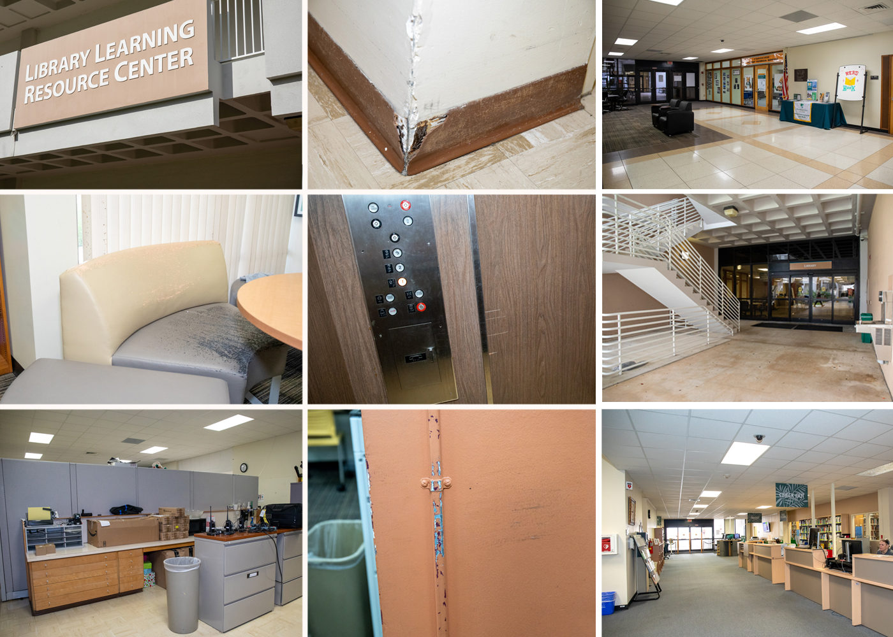
Current Library

Slide 16
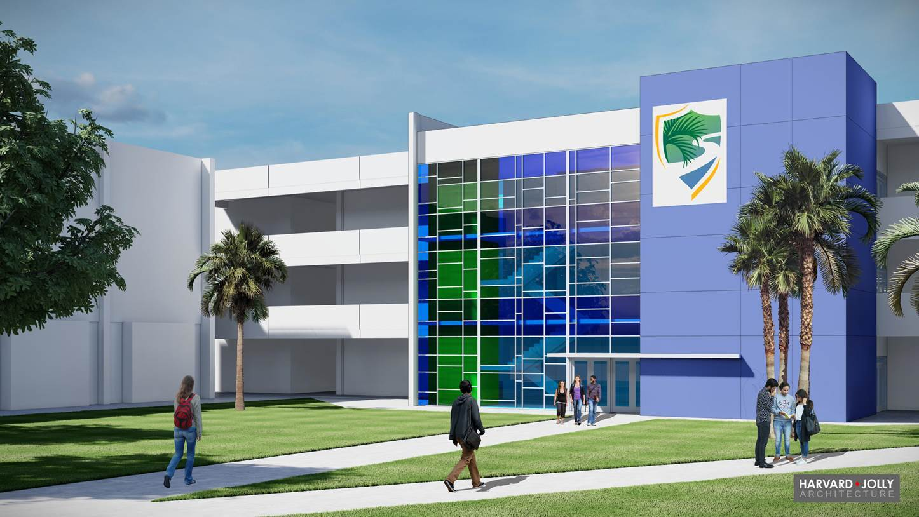
Future Rendering – front entrance

Slide 17
2024 PBSC Legislative Priorities
Emergency Response Training Center
Regional, multi-discipline facility where local, state, federal and even international teams can train together.
Increases the standards of training and knowledge and help agencies learn how to work together before an emergency.
Places us on a national, and even international, stage, thereby positioning us for more funding/grant opportunities.
Additional revenue stream; turns PBSC into a “destination” for training first responders.
$8.2 million is being requested this legislative session by Senator Berman; $4.1m by Rep. Caruso

Slide 18
2024 PBSC Legislative Priorities
Emergency Response Training Center
Phase I: received $3 million for 2023-24
    Architect has been hired for master plan location
    Solicited quotes from vendors for certain replacement equipment (paratec set, hydraulics)
    New equipment, expansion of collapse pile, ropes course
Phase II:
    “shoot” house, dive rescue
Phase III:
    Swift water training, train derailment

Slide 19
2024 PBSC Legislative Priorities
Transportation Technology Expansion Project (TTEP)
Rising demand for more autonomous/electric vehicles (EVs) = need more specialized technicians
Volvo declared its entire lineup would be EV by 2030 and General Motors pledged they would be doing the same by 2035.
Students could earn an additional clock hour certificate and be placed into high-wage jobs with local dealerships and beyond.
$3.5 million is being requested

Slide 20
2024 Florida College System Legislative Priorities
Inclusion into the State of Florida's Group Health Insurance to strengthen recruitment and retention.
Additional $150 million new recurring dollars distributed through the established funding formula
Support the DOE’s Legislative Budget Request
    Increases in Fixed Capital Outlay, Maintenance, LINE & PIPELINE grants (nursing), PECO, State Apprenticeship System
SAVE THE DATE: Trustee “fly in” – Monday, January 22, 2024 – Tuesday, January 23, 2024

Slide 21
2024 Florida College System – Workforce Education
28 colleges provide academic programs, serving 614,000 students.
Annually, 111,000 certificates and degrees are awarded.
FCS serves as the primary source of workforce education in every county throughout Florida.
Workforce programs are on campus and have always been, even through covid.
Build talent pipeline; meet community needs

Slide 22
2024 Bills
SB 62: Resident Status for Tuition Purposes
SB 114: College Applications
Closely monitoring legislation filed for 2024 that may impact higher education/PBSC

Slide 23
Questions?

Slide 24
Palm Beach State College
District Board of Trustees Meeting
October 17, 2023

Slide 25
Palm Beach State College
District Board of Trustees Meeting
Lake Worth Enrollment Data
Barbara Cipriano
Provost & Dean, Lake Worth Campus
October, 17, 2023

Slide 26

Lake Worth Campus – Who We Are
Age
Under 18 |  | 1,171 | 7.6%
18 to 19 |  | 4,318 | 28.2%
20 to 21 |  | 2,927 | 19.1%
22 to 24 |  | 2,254 | 14.7%
25 to 29 |  | 1,744 | 11.4%
30 to 34 |  | 1,029 | 6.7%
35 to 44 |  | 1,185 | 7.7%
45+ |  | 696 | 4.5%
Average age |  | 24.3
Median age |  | 21.0
Total Students: 15, 324

Slide 27
Lake Worth – Who We Are
Day students |  | 7,166 | 46.8%
Evening students |  | 2,563 | 16.7%
Day/evening |  | 1,513 | 9.9%
* Uncategorized |  | 4,082 | 26.6%
*Uncategorized students are those who are not taking a class with a defined time block, such as a Fully Online section or classes that span time blocks.

Slide 28
Student modality
All in-person/hybrid classes |  | 5,075 | 33.1%
Mix in-person/online classes |  | 3,086 | 20.1%
All fully online/live online classes |  | 7,163 | 46.7%
Total course enrollments |  | 31,902
Face-to-face, in-person |  | 15,583 | 48.8%
Fully online |  | 9,030 | 28.3%
Hybrid |  | 1,239 | 3.9%
Live online |  | 6,050 | 19.0%

Slide 29
Primary Program of Study
Baccalaureate programs 1,252 8.2%
Associate in Arts 8,688 56.7%
Associate in Science 2,294 15.0%
College Credit Certificate 280 1.8%
Career Certificate Program 770 5.0%
Apprenticeship 115 0.8%
Dual enrolled or early admission 1,145 7.5%
Transient students 64 0.4%

Slide 30
Palm Beach State College
District Board of Trustees Meeting
October 17, 2023

Slide 31
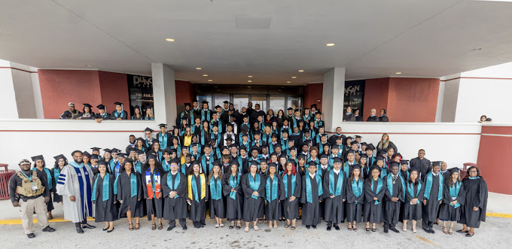
Palm Beach State College
District Board of Trustees Meeting
LEASE
Palm Beach Preparatory Charter Academy
Barbara Cipriano
Provost & Dean, Lake Worth Campus
October 17, 2023

Slide 32
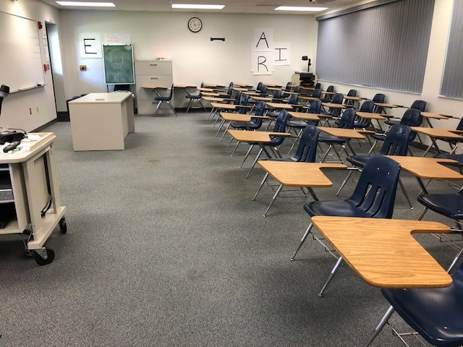
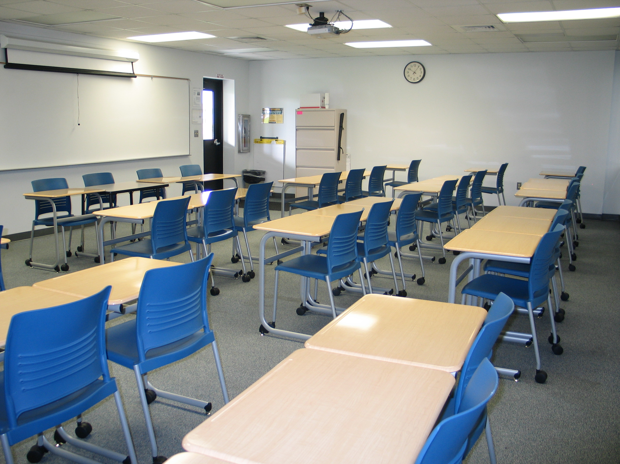
REQUEST FOR CLASSROOM SPACE
TERMS
Lease: Two (2) classrooms
Dates: Start - October 2023
End - June 30, 2024
Rent $$: $6693.75 per month
(8 months Total - $53,550)
No Partnership or Joint Venture clause
No renewal

Slide 33
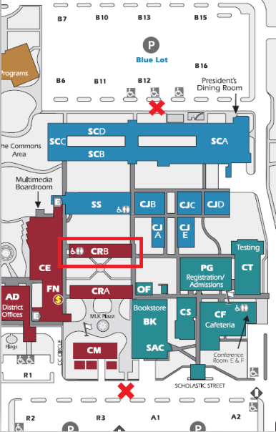
SAFETY: CONTAINED AREAS
Armed School Guardian
  Controlled Access/entry points
  Restrooms
Designated parking

Slide 34
Palm Beach State College
District Board of Trustees Meeting
October 17, 2023

Slide 35
Palm Beach State College
District Board of Trustees Meeting
Institutional
Accreditation
Dr. Roger Yohe
Vice President,
Academic Innovation & Strategy
October 17, 2023

Slide 36
Changing Accreditors: Process Overview
1. Complete SACSCOC Reaffirmation
2. Obtain DBOT Permission
3. Notify U.S. DOE
4. Approval from U.S. DOE
5. Apply for Agency Membership
6. Approval to Proceed from Agency
7. Complete Accreditation Process
8. Notify U.S. DOE
9. Receive U.S. DOE Recognition
10. Notify SACSCOC of Termination

Slide 37
Progress Update
Since the August 2023 DBOT Meeting…
August 25 – PBSC sent the letter to USDOE
August 31 – USDOE responded with a request for additional information:
  Please provide the one-page executive summary of Palm Beach State College’s QEP due 8/15/2022. Please ensure the date this was submitted to SACSCOC can be identified.
  Please provide the complete Reaffirmation Committee Report referenced in the September 29, 2022 SACSCOC letter
  Please provide any documentation that the College’s Accreditation Team used to determine that HLC would be accreditation agency which Palm Beach State College would pursue
  Please provide copies of all relevant correspondence with HLC regarding your potential application, including any materials received while attending the Annual Conference

Slide 38
Progress Update
September 12 – PBSC Responded to the USDOE request
September 14 – USDOE Request #2:
    In Palm Beach’s August 23, 2023 notification letter, although you cite SB 7044 and FS 1008.47 and its impact to allow Florida institutions to be accredited by agencies other than SACSCOC, there was no clearcut answer to if Palm Beach would be pursuing the accreditor change if SB 7044/FS 1008.47 were not applicable. Could you please advise if absent the requirements if Palm Beach would be seeking an alternative accreditor and provide explanation regarding the answer provided?
September 19 – PBSC Responded to the USDOE request

Slide 39
Progress Update
September 28 – USDOE Request:
    Please provide all communications with the State Board of Education (including all agents, employees, and representatives) or any other person or entity relating or referring to the requirements under Fla. Stat. § 1008.47 or Palm Beach’s plans to change accrediting agencies.
October 3 – PBSC Responded to the USDOE request

Slide 40
Palm Beach State College
District Board of Trustees Meeting
October 17, 2023

Slide 41
Palm Beach State College
District Board of Trustees Meeting
Approval of Bid Award
Palm Beach Gardens Stormwater Improvements
ITB 2024-011TR
Jennifer Alvarez, Director, Procurement
and
Joan Rumsey, Assistant Director, Facilities
October 17, 2023

Slide 42
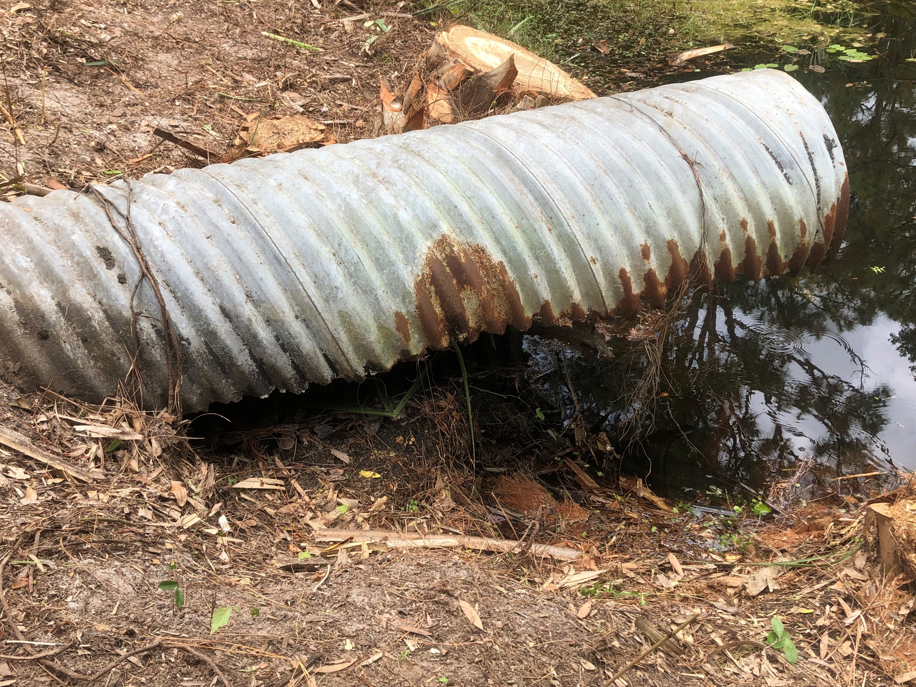
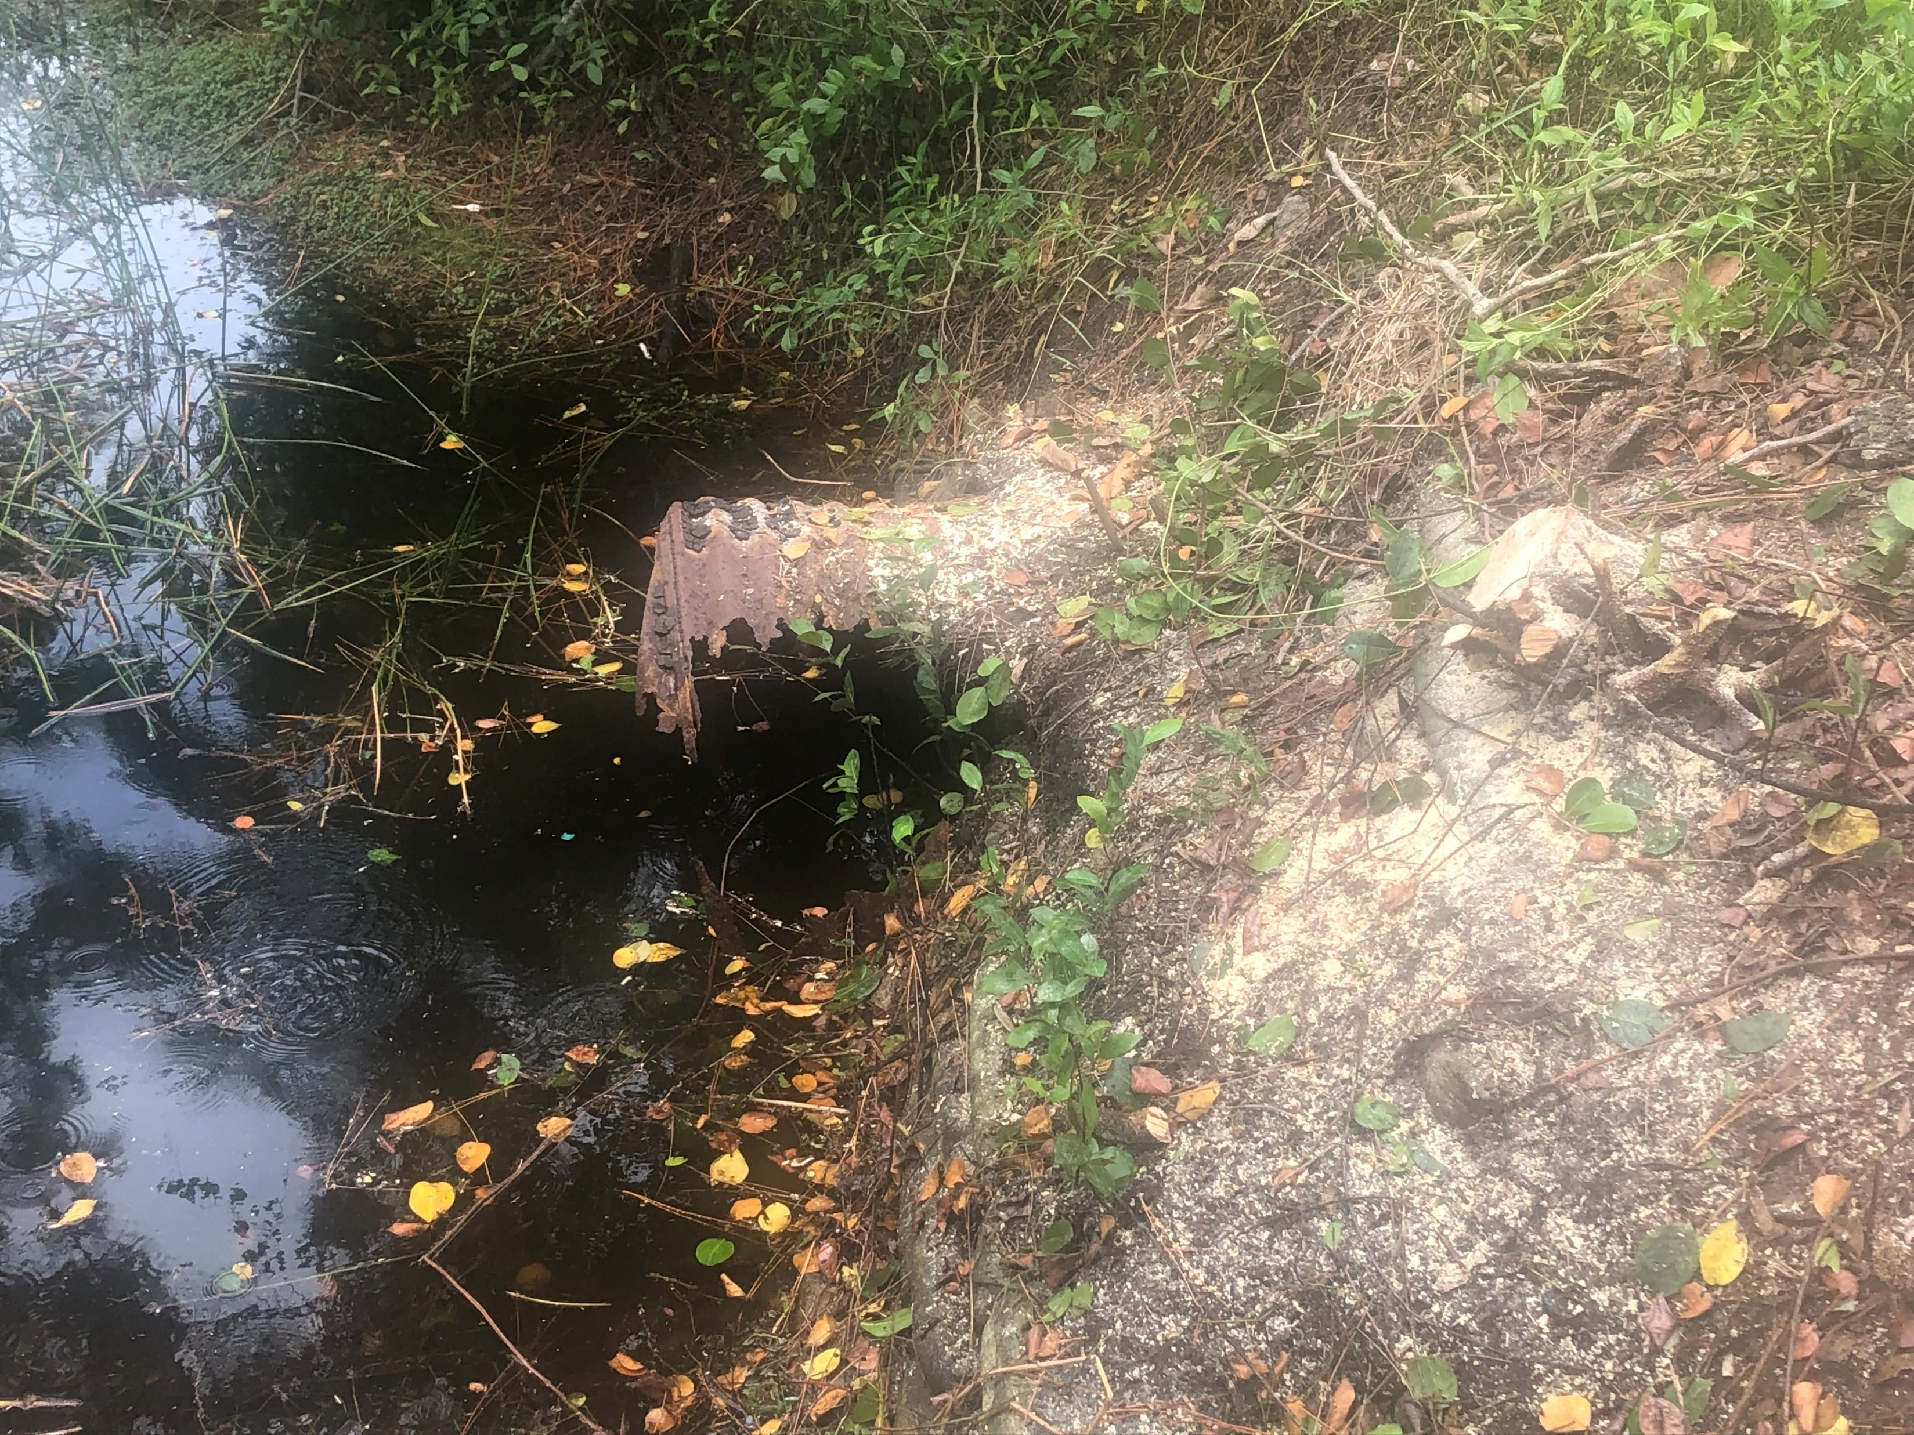
Approval of Bid Award
Palm Beach Gardens Stormwater Improvements
ITB 2024-011TR

Slide 43
Approval of Bid Award
Palm Beach Gardens Stormwater Improvements
ITB 2024-011TR
  Scope of Work includes:
    Selective demolition of damaged or deteriorating corrugated metal pipe (CMP) and replacement with new materials
    Cured in Place Pipe Lining (CIPP) within existing damaged CMP under pavement allowing parking and drive aisles to remain in service
    Removal and replacement of damaged end walls and repairing connections to existing drainage structures

Slide 44
Approval of Bid Award
Palm Beach Gardens Stormwater Improvements
ITB 2024-011TR
  The Procurement Department publicly issued the Invitation to Bid (ITB) August 1, 2023. Six responses were received:
Close Construction Services | $579,510.00
Mike Mann Construction, Inc. | $588,108.88
Prince Land, Inc. | $964,397.10
Dickerson Infrastructure, Inc. | $577,975.00
Vortex Services, LLC | $478,864.00
Timothy Rose Contracting, Inc. | $334,000.00
Engineer of Record’s cost estimate: $343,259
Recommendation is to award the contract to the lowest priced responsive and responsible bidder, Timothy Rose Contracting, Inc.

Slide 45
Approval of Bid Award
Palm Beach Gardens Stormwater Improvements
ITB 2024-011TR
  Board of Trustees Action Requested:
  Award the contract to Timothy Rose Construction, Inc in the bid amount of $334,000 plus an owner-controlled contingency of $33,400, for a total of $367,400.

Slide 46
Palm Beach State College
District Board of Trustees Meeting
October 17, 2023

Slide 47
Palm Beach State College
District Board of Trustees Meeting
Campus Safety Update
Delsa R. Bush, Ph.D.
Director, Security and Risk Management
October 17, 2023

Slide 48
Campus Safety Update
Armed Campus Safety Officers-Private Security Firm
Researched contracted providers
Colleges and District School Boards use similar services
Extra services provided
  Credentialed hiring
  Student De-escalation
  ‘Guardian’ type training (contracted rather than internal-see below)

Slide 49
Armed Certified Safe School Officer Credentials
Contract with Private Security Agency to Employ Security Officers who:
  Hold a class D and G security license
  Have completed 144 hours of required training pursuant to the Aron Feis Guardian program mandates
  Have passed a psychological evaluation administered by a licensed psychologist
  Have submitted to and passed an initial drug test and subsequent random drug tests as required by state statute
  Have successfully completed ongoing training, weapons inspection, and firearm qualifications on at least an annual basis

Slide 50
Major Benefits
Human Resources
  No recruitment or hiring
  Not responsible for discipline
  No collective bargaining
  Not responsible for employee benefits
Legal/Risk Management
  Risk sharing through the Florida College System Risk Management Consortium
Student Services
  Officers are knowledgeable and will comply with FERPA
  Behavioral Intervention Team (BIT)/Youth mental health training
  Student de-escalation techniques

Slide 51
Additional Benefits/Associated Costs
  Ability to hire eight officers, two per campus
  Continuous coverage from open to close
  Dedicated officers integrated into safety services on campuses
  $35-45 hourly range
    Approximately $650,000 Annual Budget
    Approximately twice the service hours with dedicated staff instead of random sworn officers on detail

Slide 52
Law Enforcement Agencies Update
Palm Beach County Sheriff’s Office
Only full-time Officers/40 hours per week
Multi-year contractual agreement, must hire additional officers
$172,000 plus benefits (school officer contract)
Six months to one year to implement
Can not guarantee coverage if short of staff
Palm Beach Gardens Police Department
Will not offer a contract due to current demand
Can not guarantee coverage if short of staff

Slide 53
Augment Safety Officers with Contracted Armed Security
Approve contracting with professional security firm to provide armed officers to augment campus safety.

Slide 54
Palm Beach State College
District Board of Trustees Meeting
October 17, 2023

Slide 55
Palm Beach State College
District Board of Trustees Meeting
President’s 2023-2024
Goals
Ava L. Parker, J.D.
President
October 17, 2023

Slide 56
President’s 2023-2024 Goals - Summary
Goal 1: Retention
Goal 2: Fundraising
Goal 3: Security
Goal 4: Procurement & Contracting
Goal 5: Sixth Avenue Improvement
Goal 6: 90th Anniversary Celebration
Goal 7: Establish More Business Partnerships

Slide 57
Goal 1: Retention
Implement programming and develop a culture to improve the re-enrollment and retention rates from fall to spring and spring to fall semester by 5%.

Slide 58
Goal 2: Fundraising
July 1, 2023 – June 30, 2024; $15M
  Funds raised for the last five years:
  2018-2019: $3.2M
  2019-2020: $13.2M
  2020-2021: $4.4M
  2021-2022 $4.7M
  2022-2023 $14.2M

Slide 59
Goal 3: Security
Recommend and implement an armed security system to support or replace the current non-sworn security service at the College.

Slide 60
Goal 4: Procurement & Contracting
Review contracting and procurement processes and as necessary modify to align with statewide and national best practices.

Slide 61
Goal 5: Sixth Avenue Improvement
Continue the implementation of the Sixth Avenue Improvement project including the Panther Plaza, monument signs and plans for the library upgrades and academic complex.

Slide 62
Goal 6: 90th Anniversary Celebration
Develop a year-and-a-half-long celebration to include Quarterly events, campus activities and alumni & Community engagement to expand the brand of the College.

Slide 63
Goal 7: Business Partnership
Establish more Business Partnerships to ensure we provide them with the needs of the community/industry.

Slide 64
Palm Beach State College
District Board of Trustees Meeting
October 17, 2023

Slide 65
Palm Beach State College
District Board of Trustees Meeting
October 17, 2023

Slide 66
Palm Beach State College
District Board of Trustees Meeting
October 17, 2023

